Slide 1

毕业生学位申请网上填写指南
Guidance for graduate online degree application
研究生部
Graduate Education Office

Slide 2
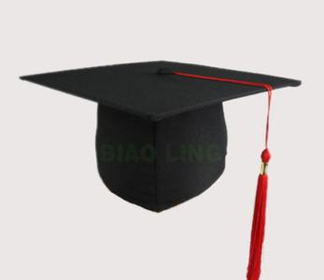
研究生培养必修环节
Graduate Cultivation Compulsory Procedure
文献
综述
论文
盲审
毕业
答辩
论文
开题
中期
考核
申请
学位
5
4
3
2
1
Degree Application
Thesis Defense
Anonymous Review
Mid-term Assessment
Thesis Proposal
Literature Review

Slide 3
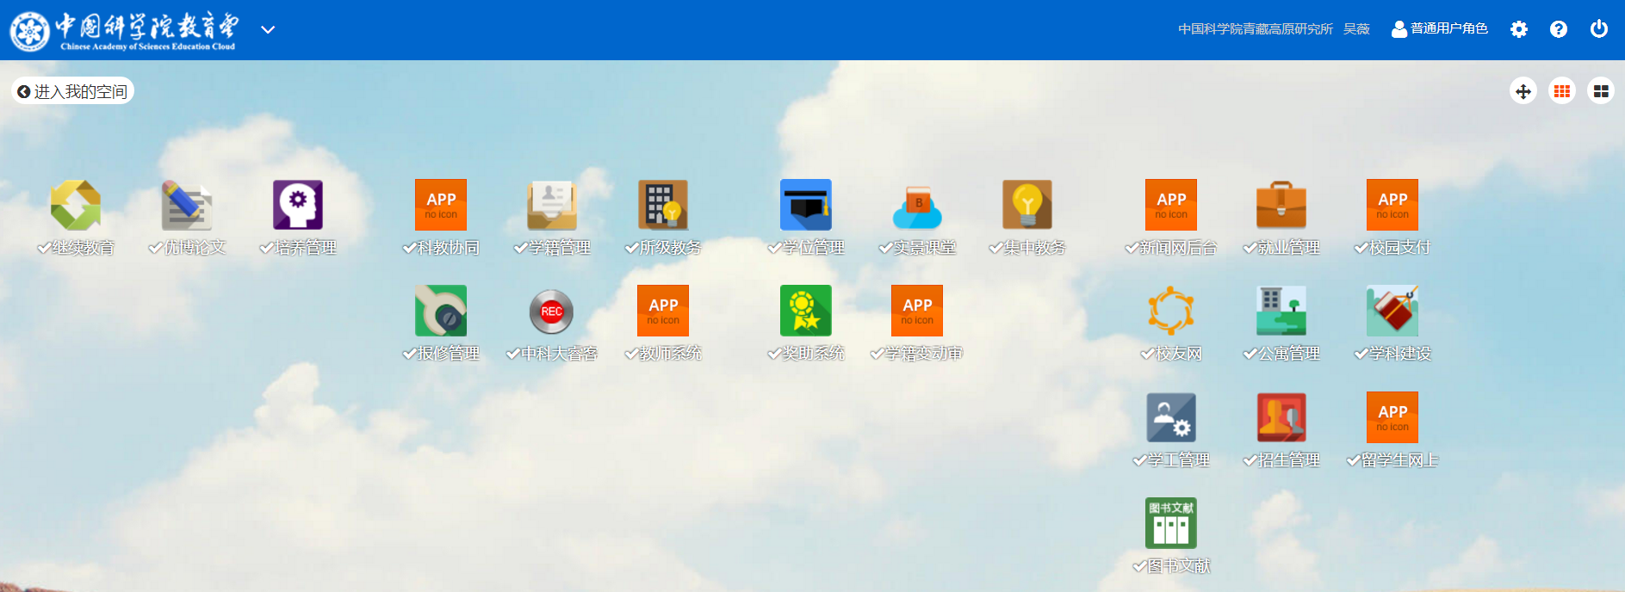
国科大教育管理平台
UCAS Online Education Management System
一个包含招生、学籍、学位、公寓、教师、就业、公寓、夏令营、科创计划、奖项申请和留学生等等为一体的网上申请和管理系统。
It is one online application and management system including admission, registration, degree, accommodation, advisor, employment, summer camp, undergraduate project, scholarship, international student and so on.

Slide 4
学位网上申请流程
Online degree application process
登录教育
管理平台
填写“培养指导”部分
提交导师
指导
提交
研究生部审核
在“学位管理”检查核对信息，上传最终版论文，下载相关表格
提交
国科大审核
Login in the website of SEP
Fill the form and upload files needed in the “Cultivation & Guidance”
Submit to advisor
Submit to Education Office of ITP
Check and upload final dissertation and download related forms
Submit to UCAS

Slide 5
各部分填写注意事项
Tips for every parts

Slide 6
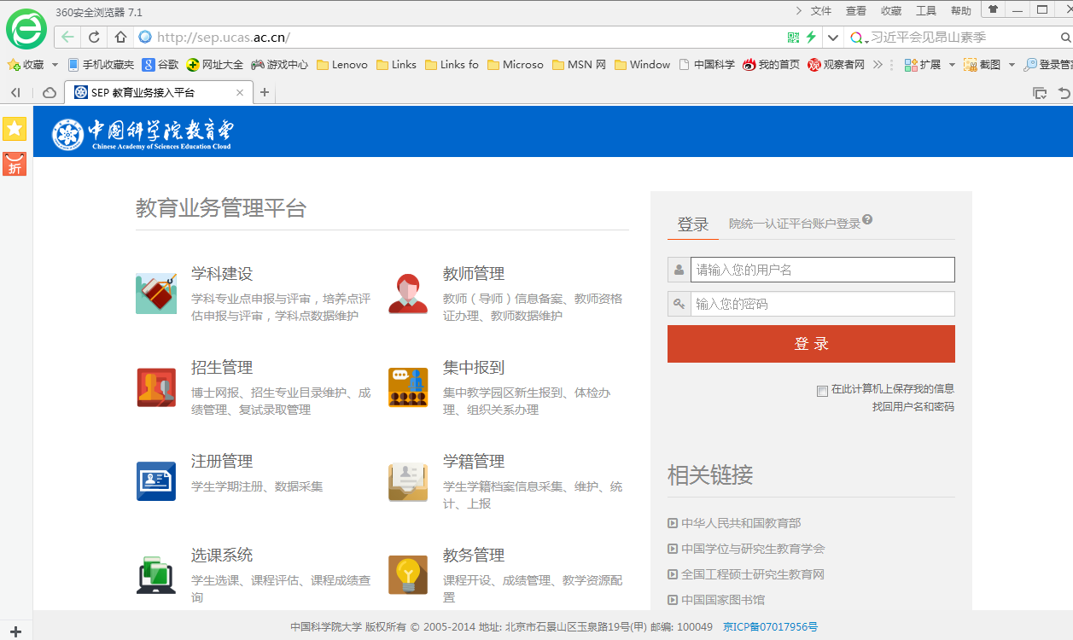
登录 Login
Website: http://sep.ucas.ac.cn
User name: e-mail address
Password: passport number
Click here to get your username or password back

Slide 7
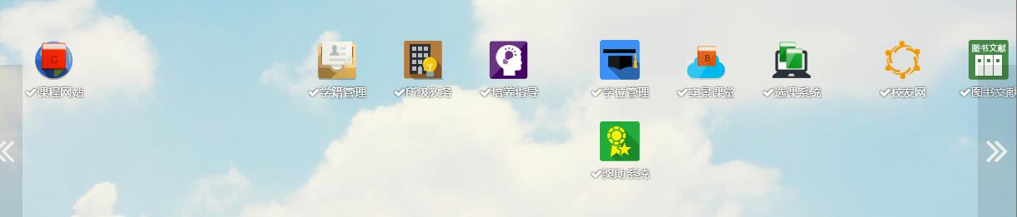
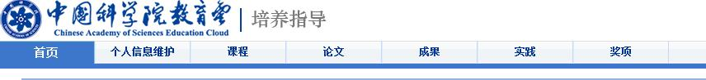
进入“培养指导”填写相关信息，上传相关文件
Fill the forms and upload your files in the part of “Cultivation & Guidance”
Cultivation & Guidance
Degree Management
Homepage
Award
Personal
Information
Social Practice
Courses
Achievement
Thesis

Slide 8
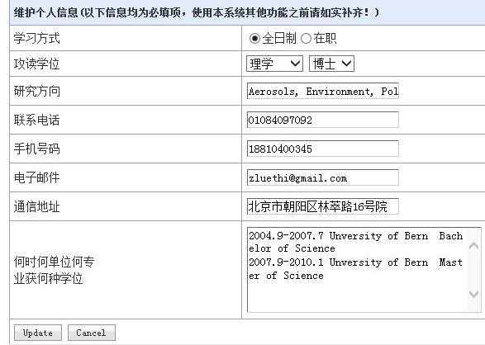
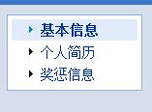
个人信息Personal Information
General Information
Cultivate type
Degree
Research Field
Telephone
Cell phone
E-mail
Postal Address
Last Degree:
time
place
major

Slide 9
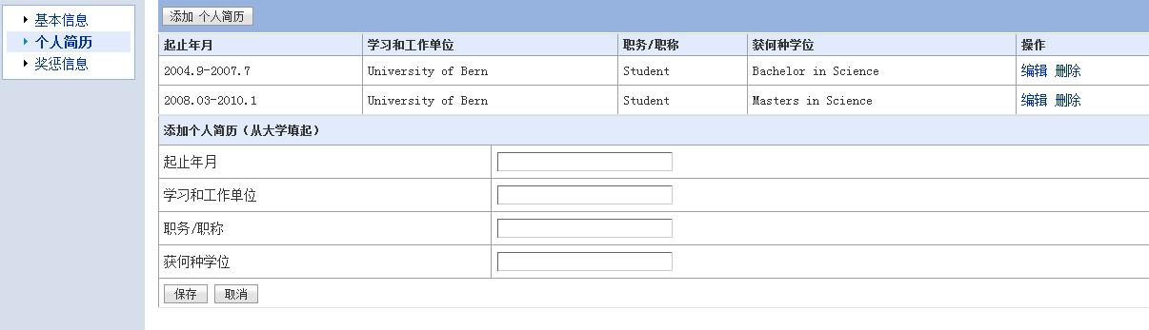
Resume
Start and finish time
Name of University/Institute
Position(student)
Degree (e.g Bachelor
/Master of Science)
Save / Cancle
个人简历从本科起填写
The resume start from bachelor degree

Slide 10
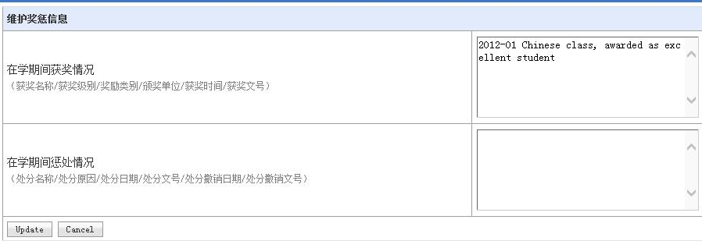
Awards and Punishment
Rewards (name, time, place etc.)
Punishment (name, time, place etc.)

Slide 11
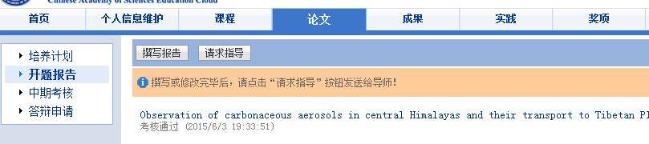
论文 Thesis
“培养计划” 和“课程情况”由研究生部统一填写
Do not fill the parts of “cultivation plan” and “course” which will finish by Graduate Education Office
Write the report
r
Submit to the supervisor
Proposal
Mid-term Assessment
Thesis apply

Slide 12
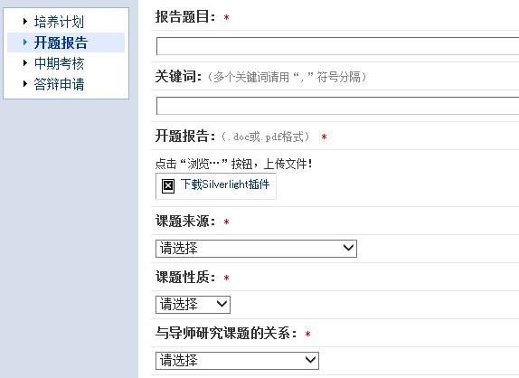
Thesis Proposal
Title of your proposal
Keywords
Upload your file in .doc/ .pdf
Choose source of your research project
Choose the nature of your research project
Usually choose the “基础研究”（basic research）
Choose the relationship of your research
with your supervisor’s project
Usually choose “是导师课题的一部分”
（part of your supervisor’s project）

Slide 13
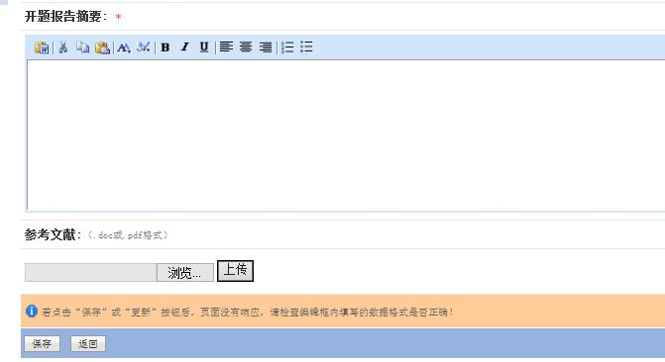
Abstract of your proposal
Reference of your proposal in .doc/.pdf
Browse / Upload
Save / Back

Slide 14
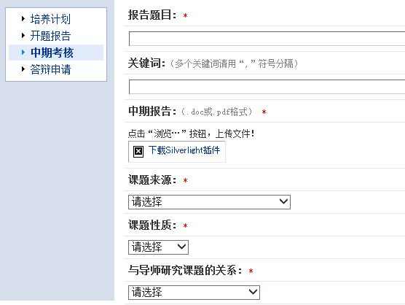
Mid-term Assessment
请将中期考核PPT转换为PDF格式上传
Please transfer the PPT of mid-term to PDF and then upload
Title of your report
Keywords
Upload your report in .doc/.pdf
Choose source of your research project
Choose the nature of your research project
Usually choose the “基础研究”（basic research）
Choose the relationship of your research
with your supervisor’s project
Usually choose “是导师课题的一部分”
（part of your supervisor’s project）

Slide 15
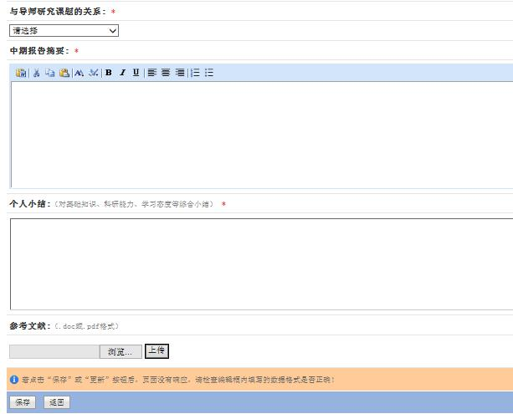
Abstract of your report
Self-summary about
the basic knowledge,
research ability,
study attitude and so on
Reference of your report in .doc/.pdf
Browse / Upload
Save / Back

Slide 16
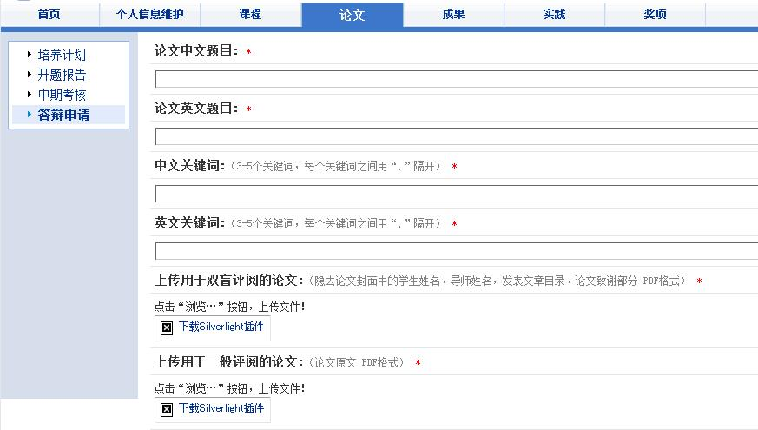
Thesis-defense application
Chinese title of thesis
English title of thesis
Chinese keywords
English keywords
Upload the thesis version for
the anonymous Review with
no name, supervisor, publication,
reference or acknowledgement
in .pdf
Upload the original thesis in .pdf

Slide 17
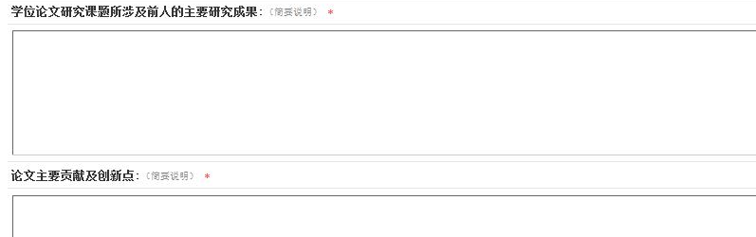
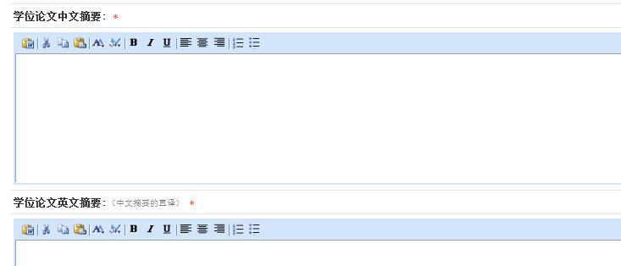
Main research results of predecessor in your thesis
Main contribution and innovation points of your thesis
Chinese abstract
English abstract

Slide 18
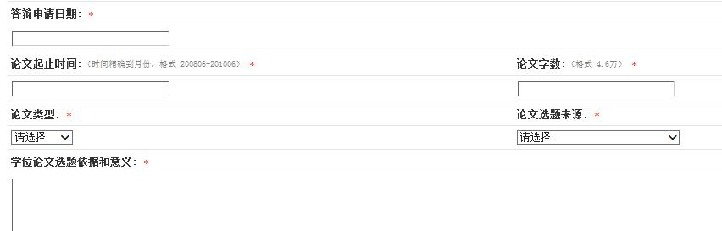
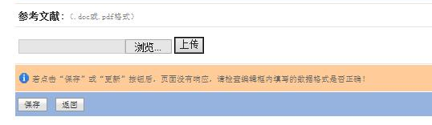
Date of thesis apply
Total number of the words
Begin and end date of your thesis
Type of your thesis
Basic and significance of dissertation
Source of your thesis
Reference of your thesis in .doc/.pdf
Browse / Upload
Save / Back

Slide 19
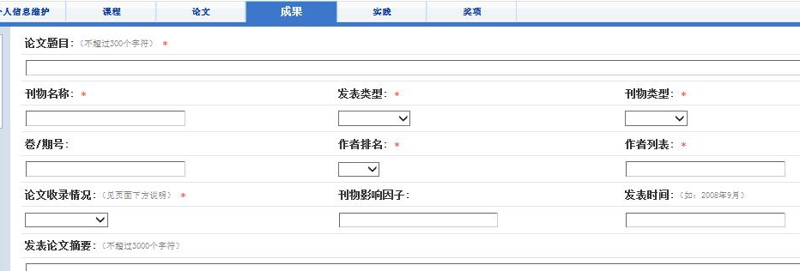
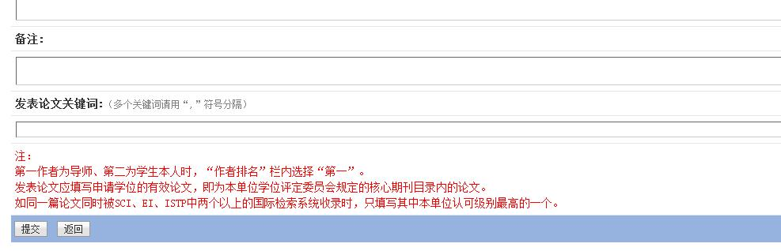
成果 Achievement
This part usually is your publications.
Title
Type of the
journal
International
/domestic
Name of the journal
Published/
already received
Volume No.
Author Rank
Author List
Paper collection situation
Impact factor
Published date
Abstract
Notes
Keywords
Submit/back

Slide 20
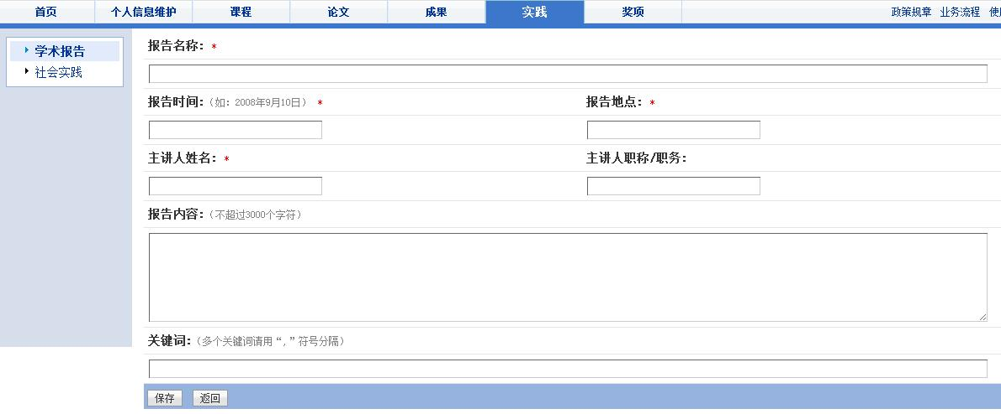
包括including：
所听学术报告10次/年 lectures attend 10 times a year
所作学术报告，至少1次 lecture you make, at least once
所参加野外工作 field work you participate
所参加实验室工作 lab work you participate
社会实践 Social Practice
Academic report
Title of the lectures you attend
Date
venue
Lecturer
Title of the lecturer
Content of the lecture
Keywords
Save / Back

Slide 21
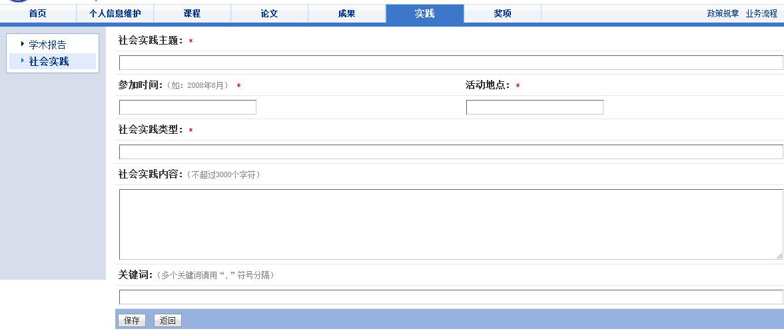
Social practice, usually your field work
Subject of your practice
Time
Place
Type
Content
Keywords
Save / Back

Slide 22
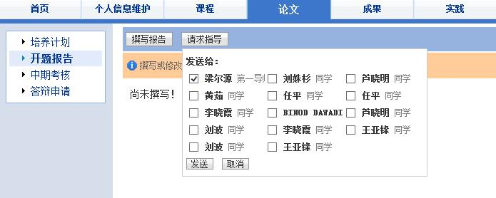
所有部分填写完成后都要点击“请求导师指导”
Click “submit” to advisor for check
Including :
Proposal
Mid-term Assessment
Thesis-defense application
Choose your supervisor
Send
Cancel

Slide 23
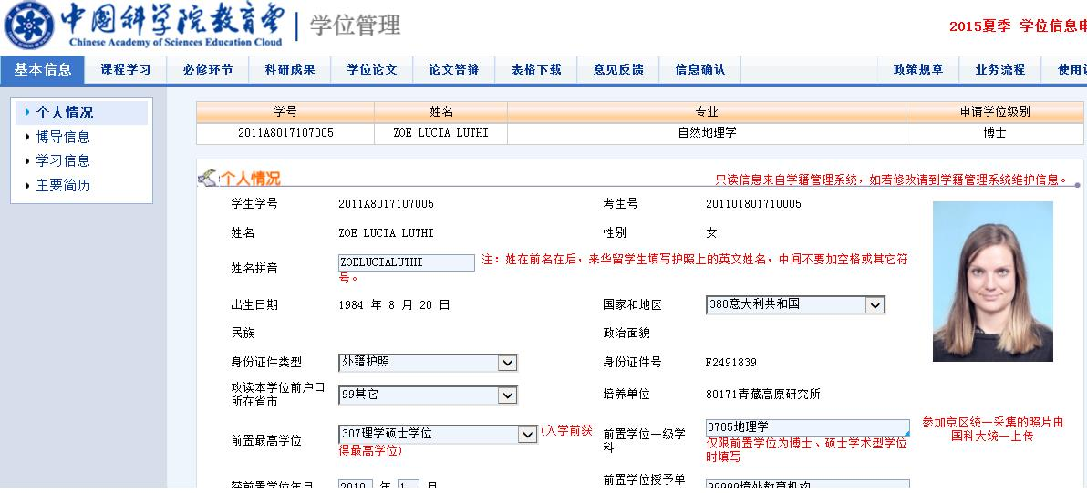
进入“学位管理”检查核对信息
Go to “degree management” part to check your information
Degree Management
Check one by one!

Slide 24
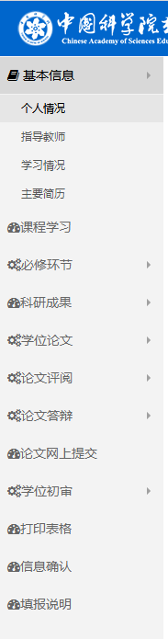
研究生部审核通过后，点击“同步数据”后逐一核对信息，补充完整信息，重点核对：
Click “synchronizing” and check your information,
especially the following parts:
1）个人信息，导师信息
Personal and advisor’s information
2）开题、中期等时间、地点、结果
Time, venue and result of proposal and mid-term
3）盲审成绩
Score of anonymous review
4）答辩投票结果
Voting result of thesis defense
5）最终版论文
Final dissertation
Print related forms
Confirm your information after checking!

Slide 25

Thank you!
&
Congratulations!

